Slide 1


Who Moved My Cheese?
An Amazing Way to Deal With Change In Your Work & In Your Life
DR SPENCER JOHNSON

Slide 2
“Cheese” – a metaphor for what we want to have in life, whether it is a job, a relationship, money, a big house, freedom, health, recognition, spiritual peace, or even an activity like jogging or golf.
Each of us has our own idea of what Cheese is, and we pursue it because we believe it makes us happy. If we get it, we often become attached to it. And if we lose it, or it’s taken away, it can be traumatic.

Slide 3

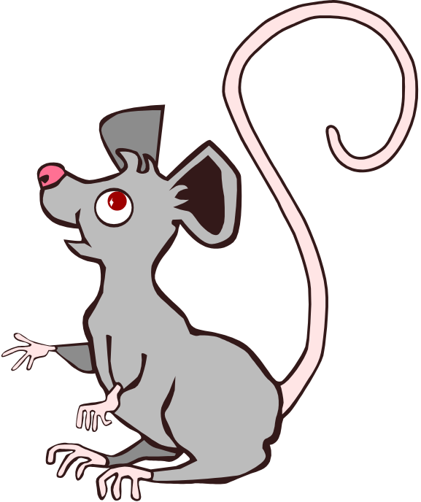

ONCE, long ago, there lived 4 little characters who ran through a maze looking for cheese to nourish them & make them happy.
Two were mice named “Sniff” & “Scurry” and two were little people named “Hem” & “Haw”.

Slide 4


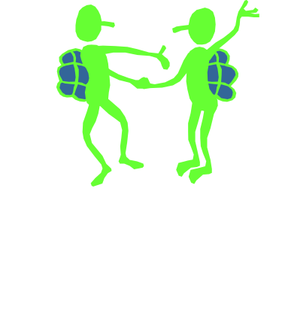
Every morning, the mice & the little people dressed in their running gear & headed over to Cheese Station C where they found their own kind of cheese. It was a large store of Cheese that Hem & Haw eventually moved their homes to be closer to it & built a social life around it.
To make themselves feel more at home, Hem & Haw decorated the walls with sayings. One read:

Slide 5

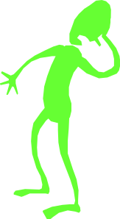
One morning, Sniff & Scurry arrived at Cheese Station C & discovered there was no cheese.
They weren’t surprised. Since they had noticed the supply of cheese had been getting smaller every day, they were prepared for the inevitable & knew instinctively what to do. They were quickly off in search of New Cheese.
Later that same day, Hem & Haw arrived. “What! No Cheese? Who moved my Cheese? It’s not fair!”, Hem yelled. They went home that night hungry & discouraged. But before they left, Haw wrote on the wall:

Slide 6
The More Important Your Cheese is To You, The More You Want To Hold Onto It.

Slide 7


The next day Hem & Haw left their homes, & returned to Cheese Station C. But situation hadn’t changed. Haw asked, “Where are Sniff & Scurry? Do you think they know something we don’t?” Hem scoffed, “What would they know? They’re just simple mice. They just respond to what happens. We’re little people. We’re smarter.”
Haw suggested, “Maybe we should stop analyzing the situation so much and just get going & find some New Cheese.
Haw decided to leave Cheese Station C while Haw was more comfortable staying in the cheeseless Station C. Hem announced, “It’s MAZE time!” and wrote:

Slide 8
If You Do Not Change, You Can Become Extinct

Slide 9
Having Cheese Makes You Happy

Slide 10
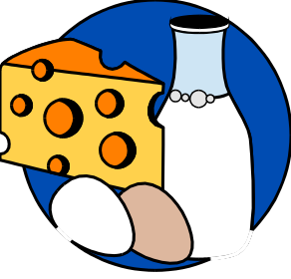

Meanwhile, Sniff & Scurry went farther into the maze until they found Cheese Station N. They found what they had been looking for: a great supply of New Cheese. It was the biggest store of cheese the mice had ever seen.
Haw on the other hand become more anxious & wondered if he really wanted to go out into the Maze. He wrote a saying on the wall ahead of him & stared at it for some time:

Slide 11
What Would You Do If You Weren’t Afraid?

Slide 12

Haw now realized that the change probably would not have taken him by surprise if he had been watching what was happening all along and if he had anticipated change. He stopped for a rest & wrote on the wall of the Maze:

Slide 13
Smell The Cheese Often So You Know When It Is Getting Old.

Slide 14


Haw wondered if Hem had moved on, or if he was still paralyzed by his own fears. Then, Haw remembered the times when he had felt his best in the Maze. It was when he was moving along. He wrote:

Slide 15
Movement In A New Direction Helps You Find New Cheese.

Slide 16

As Haw started running down the dark corridor, he began to smile. Haw didn’t realize it yet, but he was discovering what nourished his soul. He was letting go & trusting what lay ahead for him, even though he did not know exactly what it was.
To his surprise, Haw started to enjoy himself more & more. He stopped to write again on the wall:

Slide 17
When You Move Beyond Your Fear, You Feel Free.

Slide 18
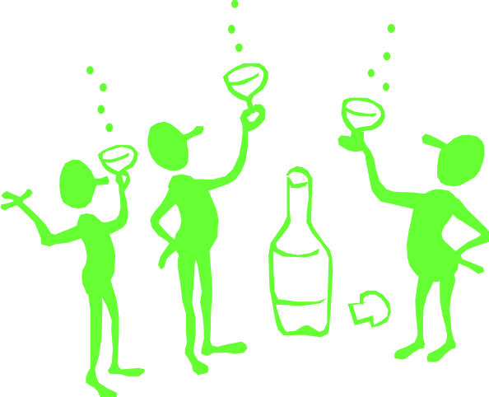
To make things even better, Haw started to paint a picture in his mind again. He saw himself in great realistic detail, sitting in the middle of a pile of all his favorite cheeses-from Cheddar to Brie! He saw himself eating the many cheeses he liked, & he enjoyed what he saw.
The more clearly he saw the image of himself enjoying New Cheese, the more real & believable it became. He wrote:

Slide 19
Imagining Myself Enjoying New Cheese, Even Before I Find It, Leads Me To It.

Slide 20

Haw wondered why he had always thought that a change would lead to something worse. Now he realized that change could lead to something better.
Then he raced through the Maze with greater strength & agility. Until he found bits of New Cheese. He entered the Cheese Station but it was empty. Someone had already been there.
He stopped & wrote on the wall:

Slide 21
The Quicker You Let Go Of Old Cheese, The Sooner you Find New Cheese.

Slide 22

Haw made his way back to Cheese Station C to offer Hem bits of New Cheese but was turned down. Hem wanted his own Cheese back. Haw just shook his head in disappointment but this does not stop him from finding New Cheese. He smiled as he realized:

Slide 23
It Is Safer To Search In The Maze Than Remain In The Cheeseless Situation.

Slide 24

Haw realized again, that what you are afraid of is never as bad as what you imagine. The fear you let build up in your mind is worse than the situation that actually exists.
He realizes it was natural for change to continually occur, whether you expect it or not. Change could surprise you only if you didn’t expect it & weren’t looking for it.
When he realized he had changed his beliefs, he paused to write on the wall:

Slide 25
Old Beliefs Do Not Lead You To New Cheese.

Slide 26
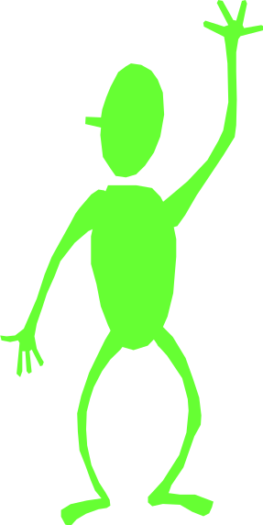
Haw now realized that his new beliefs were encouraging him to behave in a new way. He was behaving differently from the way he had when he had kept returning to the same cheeseless station.
It all depends on what you choose to believe. He wrote on the wall:

Slide 27
When You See That You Can Find And Enjoy New Cheese, You Change Course.

Slide 28


Haw just hoped he was heading in the right direction. He thought about the possibility that Hem would read The Handwriting On The Wall & find his way.
He wrote on the wall what he had been thinking about for some time:

Slide 29
Noticing Small Changes Early Helps You Adapt To The Bigger Changes That Are To Come.

Slide 30
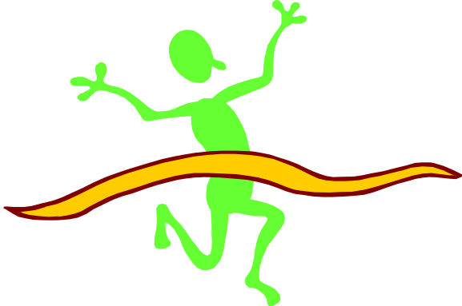
He continued on through the Maze with greater strength & speed. He proceeded along a corridor that was new to him, rounded a corner, & found New Cheese at Cheese Station N where he saw the greatest supply of Cheese he had ever seen.Sniff & Scurry welcomed him.
“Hooray for Change!”
Haw wrote down a summary of what he had learned on the largest wall of Cheese Station N & smiled as he looked at what he had learned:

Slide 31
THE HANDWRITING ON THE WALL
Change Happens
Anticipate Change
Monitor Change
Adapt To Change Quickly
Change
Enjoy Change !
Be Ready To Change Quickly & Enjoy It Again.

Slide 32
Move With The Cheese & Enjoy It !

